Slide 1
Presentation in regard to Project Final Defense
AN INTELLIGENT DEEP CONVOLUTIONAL NEURAL NETWORKS BASED ISLANDING DETECTION FOR MULTI-DG SYSTEMS
Presented By:
Basant Raj Tiwari PAS079MSDGE001
Supervised By: Er. Sushmita Poudel
Presented At:
Department of Electrical Engineering,
MSc in Electrical Engineering in
Distributed Generation

Slide 2
Introduction
Unintentional Islanding; DGs still supplying the local loads though it is disconnected form Utility.
Tripping of CB, sudden faults, load switching, human error, unbalanced power are the primary causes of Unintentional Islanding.
Islanding detection is a non-trivial task for safe operation of Microgrid or EPS with DG systems
Islanding Detection should justify dependability, security and fast response time.

Slide 3
Continued....
Several Local (active, passive and hybrid ) and Remote methods are available for IDT.
Intelligent Classifier Based Schemes are preferred over conventional techniques
So CNN based IDT is also one of the intelligent classifier based schemes.
Low Non Detection Zone, Fast Detection Time and No power quality issues are the driving factors to opt for CNN based IDT.

Slide 4
Problem Statement
Consequences are bound to happen during unintentional islanding:
Inability of DG’s to handle the abrupt change.
Synchronization issue during re-connection.
Uncontrollable behavior of DG’s due to power mismatch.
So a reliable, fast and low non-detection zone technique is required for
accurate detection of Islanding and CNN based IDT posses these indices.

Slide 5
Objectives
Primary Objective:
To study the efficacy of proposed CNN based IDT for various Islanding scenarios based on performance indices like Detection Time, Non-detection Zones, Accuracy and Selectivity.
Secondary Objectives:
To study the ideas of Deep Learning Techniques.
To study the Signal Processing Techniques like DFT, STFT and Wavelet Transform.
To study how the proposed IDT stands out in contrast to other IDTs

Slide 6
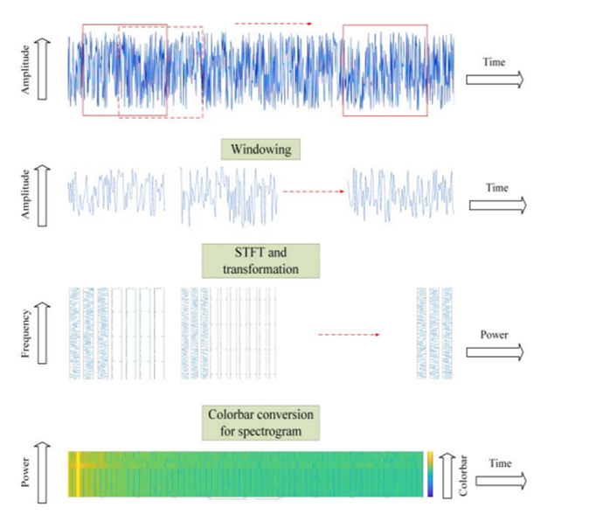

Literature Review
Short-term Fourier Transform:
Employed for time-frequency analysis
in this project.
Breaks down a signal into smaller,
potentially stationary segments &
analyzes them using a moving window.
Mathematically it can shown as:
Figure 1: Short-Term Fourier Transform Working.

Slide 7
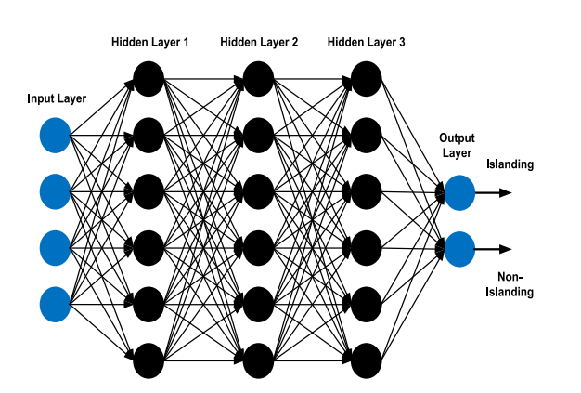
Continued....
Convolutional Neural Network:
A well-known deep learning architecture influenced by the automatic visual experience of living beings. .
Uses end-to-end learning, which means that the classifier discovers all the features and then classifies the images, resulting in a data-driven method.
Convolutions layer constructs a feature map to predict class probabilities.
Figure 2: A Typical CNN Architecture .

Slide 8
Methodology
Project is based on CNN and STFT computation for time-frequency analysis.
Stages of the proposed method is illustrated in the Flowchart.
Collection of three-phase voltage data at PCC under
various islanding and non-islanding conditions.
Concatenation of the three-phase voltage data creating a
single array of voltage data.
3. Transformation into frequency spectrum time variations
by STFT for time-frequency analysis.
4. Phase and magnitude of the frequency spectrum numeric
data concerning time variations are fed into the CNN.

Slide 9
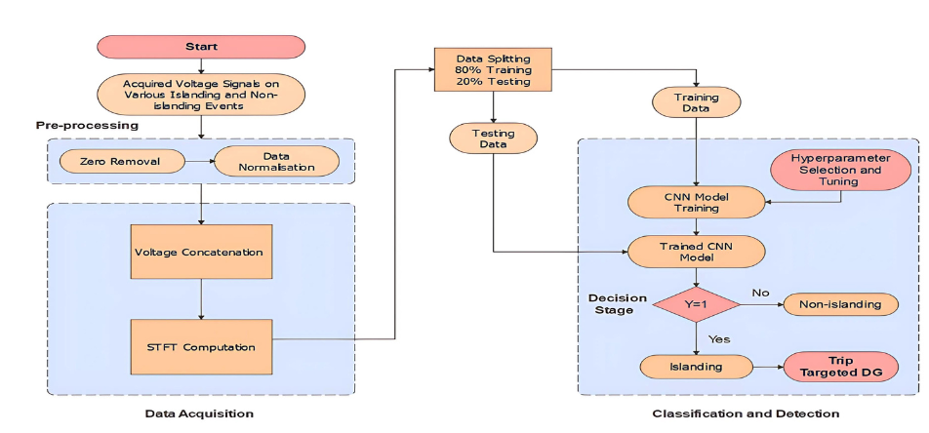
Continued....
Figure 3: Flowchart of Proposed IDT .

Slide 10
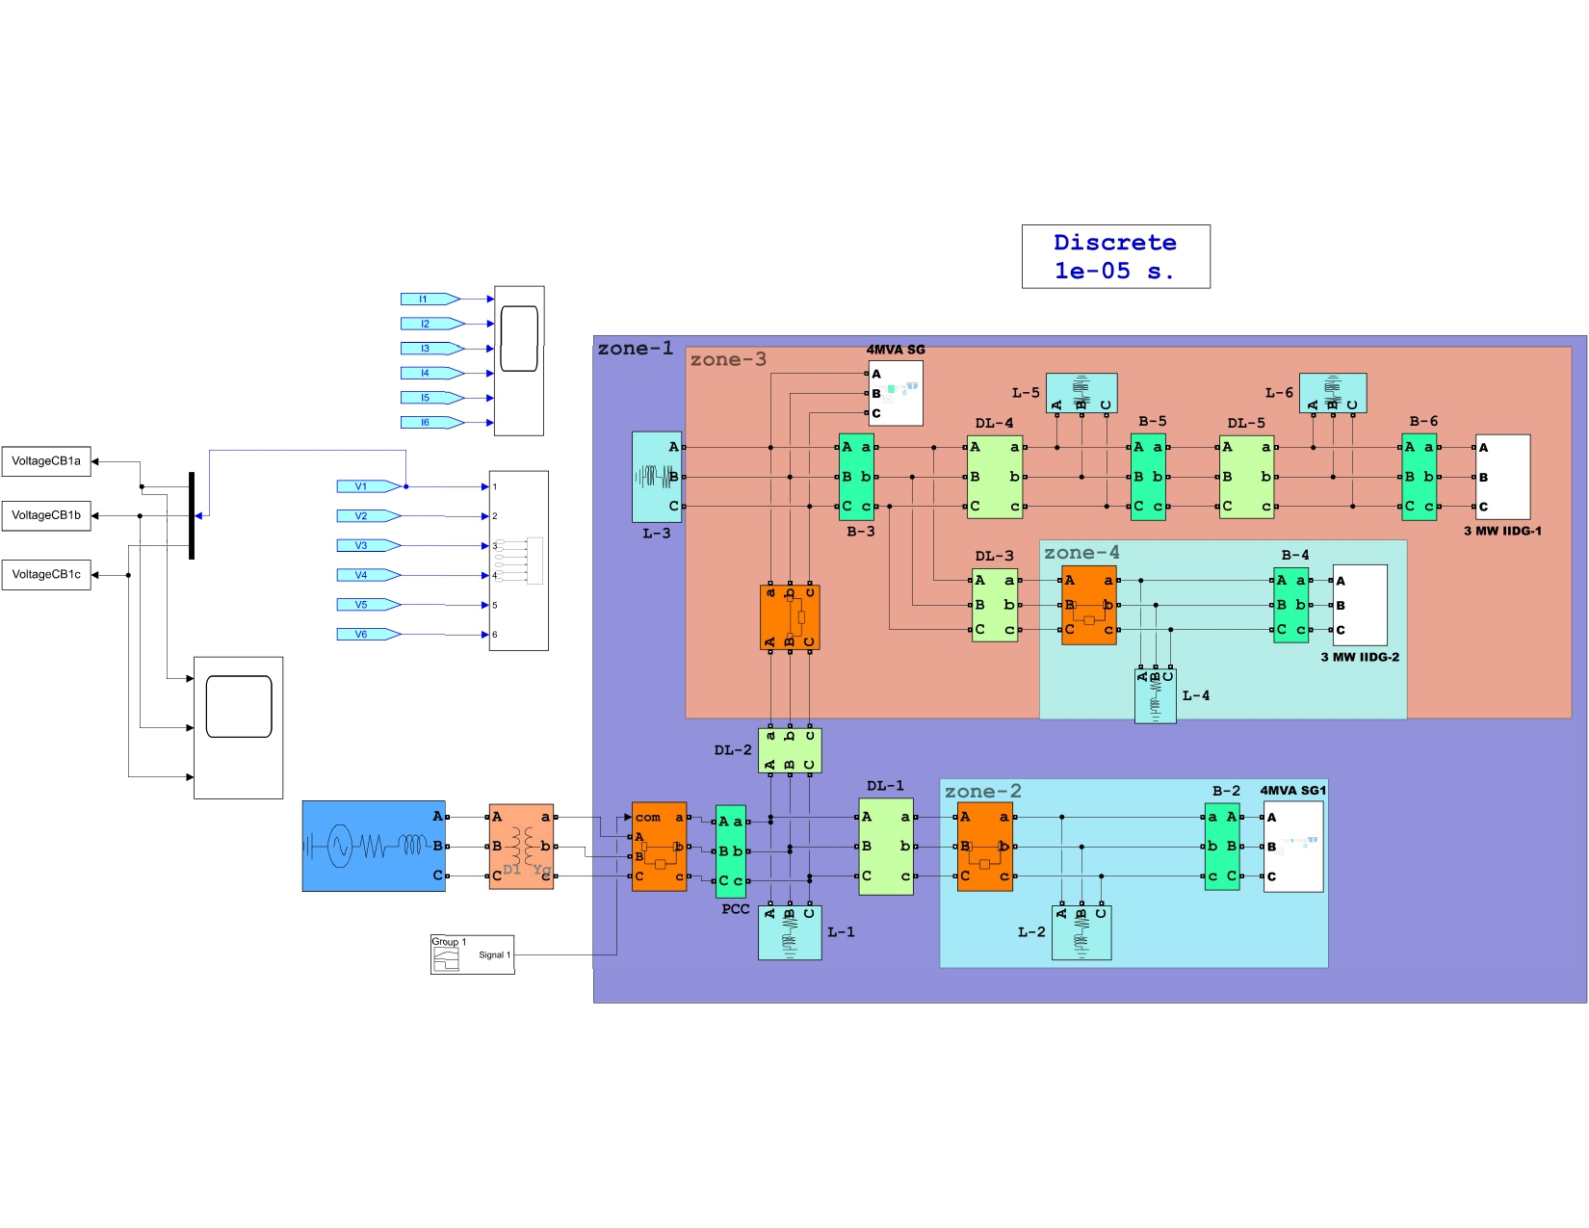
Continued....
Figure 4: Simulink model of test system

Slide 11
Continued....
DATA RETREIVAL PROCESS:
Obtain the Voltage data at PCC during the individual islanding and non-islanding scenario with a simulation time of 0.75s.
Export the voltage data back to the MATLAB workspace in the timeseries dataset with a sampling frequency of 3840Hz.
Perform STFT for acquired data using the in-built function spectrogram () or Divide the sampled data into non-overlapping chunks and each chunk is Fourier transformed to obtain the complex frequency spectra.
Image data is stored and classified under two categories islanding and non-islanding for training and testing data.

Slide 12
TASKS PERFORMED
DATA EXTRACTION :
Based on the table alongside various scenarios of
islanding and non-islanding were realized.
The images were stored within classification label folders and fed to the CNN training code.
Some instances of images are shown in next slide.
Islanding and non-islanding cases on various disturbances | No. of Cases
Islanding Islanding by changing ∆P and ∆Q from (-50% to +50%) and (-25% to +25%) respectively. Non detection Zones cases | 1050 800 250
Non-islanding Faults on DL-1 and DL-2 (SLG, DLG, TLG) by changing fault resistance from (0.1-100 Ω). Load Switching on L2, L4, L5 in the range of (0.5-50 MVA), (5-55 MVA), (10-70 MVA). | 1050 980 70
Total Islanding and non-islanding cases | 2100
Figure 5: Data Mining for proposed IDT

Slide 13
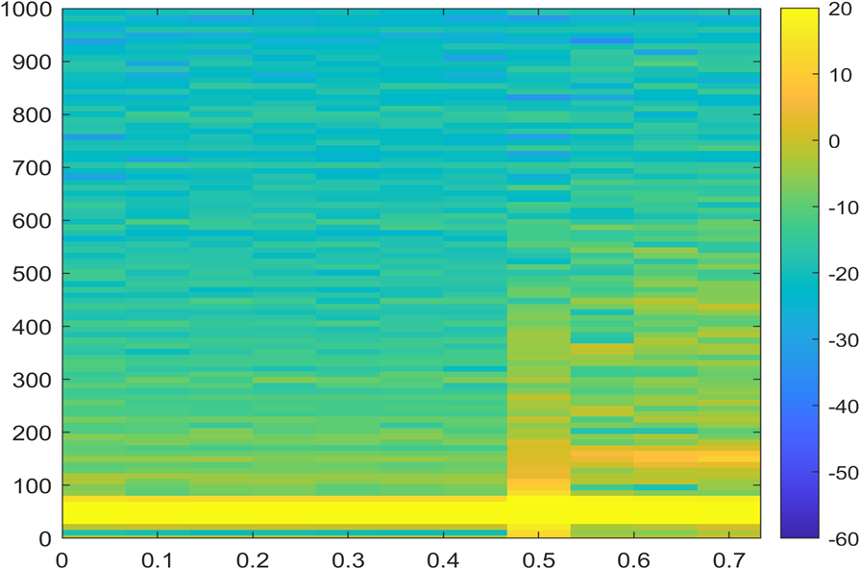
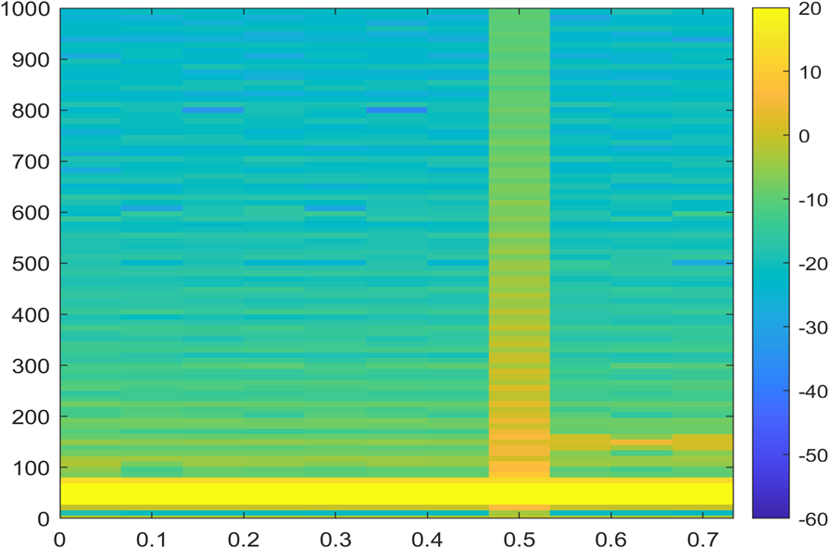
Continued....
Figure 6: Spectrogram of Voltage waveform at Bus-4 during zone-4 islanding.
Figure 7: Spectrogram of voltage signal during SLG fault (non-islanding) at DL-1.

Slide 14
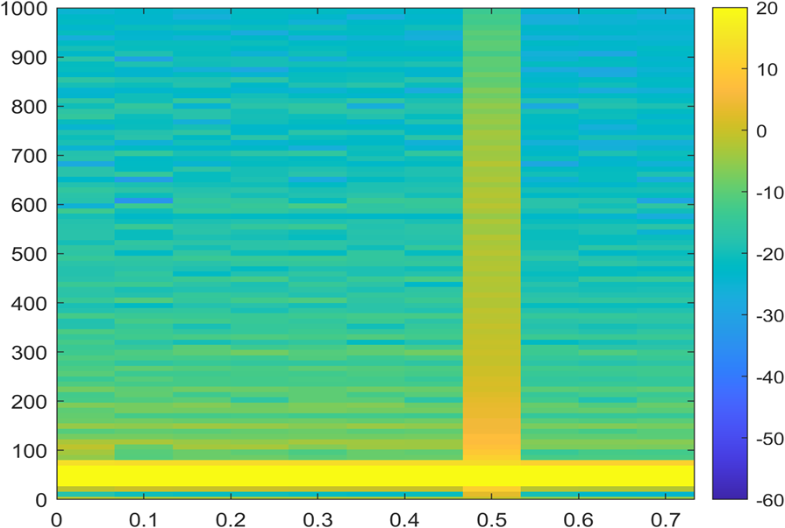
Continued....
Figure 8: Spectrogram of voltage signal during load switching (non-islanding) at zone 2

Slide 15
Continued....
MODELLING AND TRAINING OF CNN:
Training Options: -
Optimizer: SGDM (Stochastic Gradient Descent with Momentum)
Initial Learn Rate: 0.01
Max Epochs: 10
Mini Batch Size: 32
Shuffle: Every epoch
Validation Frequency: 30
Execution Environment: CPU
Figure 9: CNN Architecture

Slide 16
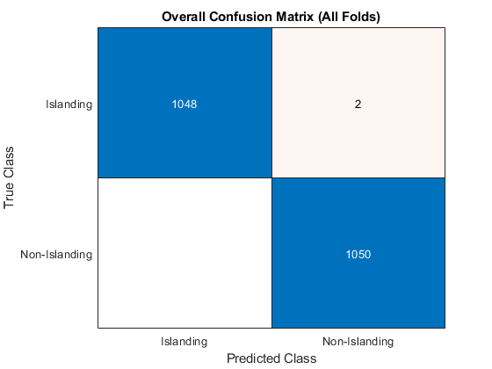
RESULTS AND DISSCUSSIONS
Confusion Matrix show two mis-classification.
Mean Accuracy : 99.9%
Validation Method is done k-fold validation method. Here k=5 was used.
After the model was trained it was further tested on arbitrary examples presented on next slide.

Slide 17
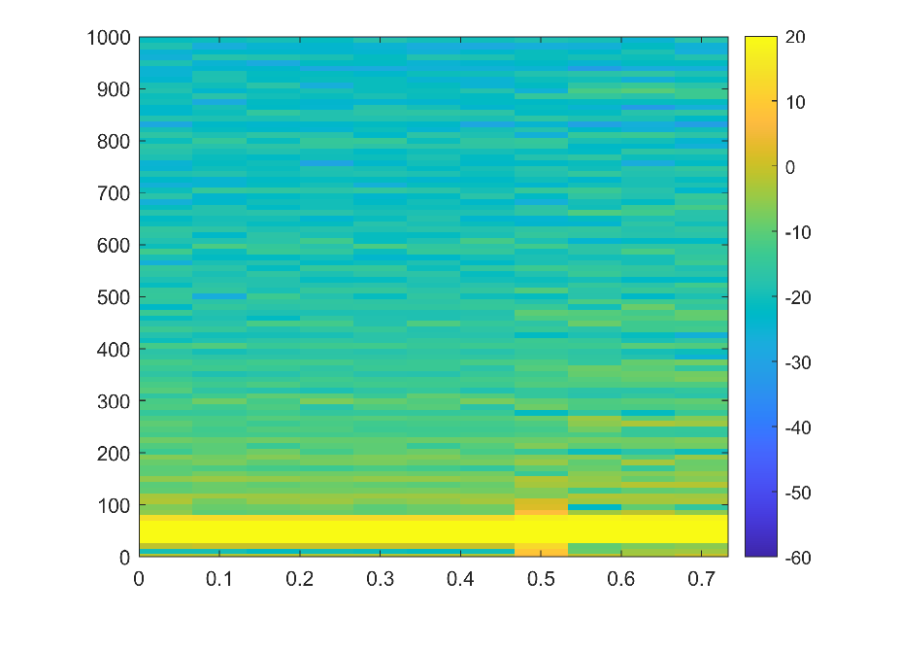
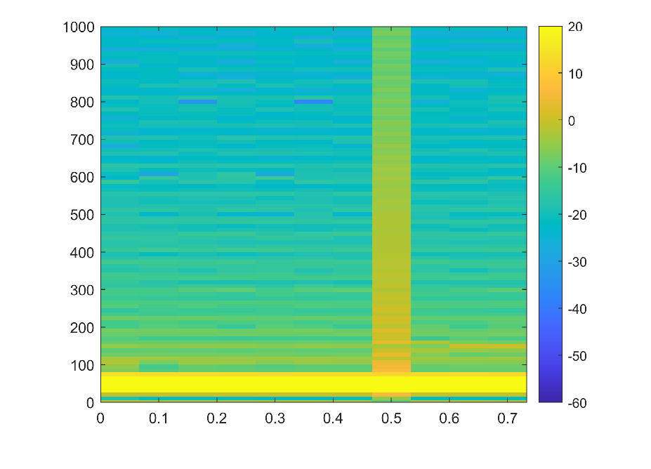
Continued....
Arbitrary Example 1: Islanding created at 0.5s with generation and load being almost similar (a case of NDZ) at the zone of interest.
Arbitrary Example 2: Non-islanding created at 0.5s.
message = " The abnormality in voltage waveform does not correspond to islanding condition"
message1 =" The confidence level of classification is 99.2865 %"
message = "Islanding Condition Detected"
message1 = " The confidence level of
classification
is 99.9029 %"

Slide 18
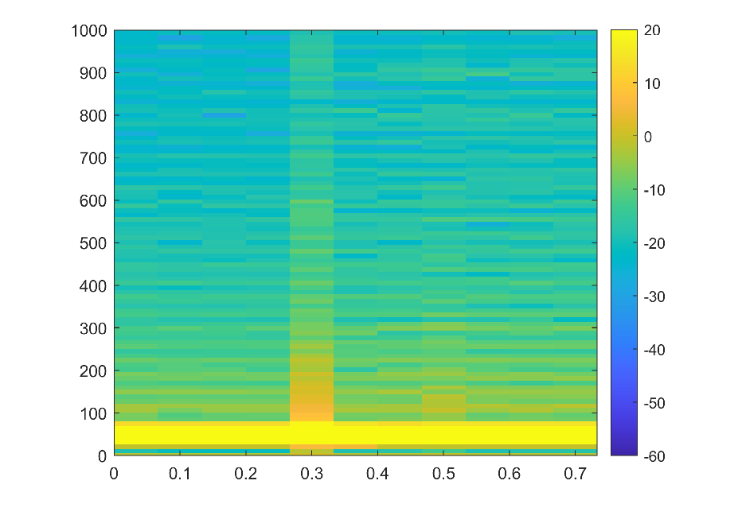
Continued....
Findings
Each validation case were generated in Simulink to realize the islanding condition.
But to assess the detection time the model has to applied to real –time test hardware system.
One has to continuously monitor the PCC voltage in real grid system and perform the check computation at required sampling frequencies.
Arbitrary example 3: Islanding created at 0.3s.
message = "Islanding Condition Detected"
message1 = " The confidence level of
classification
is 99.9029 %"

Slide 19
CONCLUSION
CNN can be used to detect the islanding and non-islanding conditions with great accuracy of 99.9%
Once we train a model, we can use that trained model for classifying the voltage signals measured at PCC.
The classifier will classify the signal and may send a corresponding signal to controller to make further
decisions on opening or avoiding the opening of CBs.
The findings also imply that efficient DG islanding detection in real-time applications may be accomplished using deep learning-based approaches.

Slide 20
References
[1] A. Khamis, H. Shareef, E. Bizkevelci, and T. Khatib, ‘‘A review of islanding detection techniques for renewable distributed generation systems,’’ Renew. Sustain. Energy Rev., vol. 28, pp. 483–493, Dec. 2013, doi: 10.1016/j.rser.2013.08.025
[2] A. Hussain, C.-H. Kim, and A. Mehdi, ‘‘A comprehensive review of intelligent islanding schemes and feature selection techniques for distributed generation system,’’ IEEE Access, vol. 9, pp. 146603–146624, 2021.
[3] S. R. Mohanty, N. Kishor, P. K. Ray, and J. P. S. Catalo, ‘‘Comparative study of advanced signal processing techniques for islanding detection in a hybrid distributed generation system,’’ IEEE Trans. Sustain. Energy, vol. 6, no. 1, pp. 122–131, Jan. 2015, doi: 10.1109/TSTE.2014.2362797.
[4] C.-T. Hsieh, J.-M. Lin, and S.-J. Huang, ‘‘Enhancement of islanding detection of distributed generation systems via wavelet transform-based approaches,’’ Int. J. Electric. Power Energy Syst., vol. 30, no. 10, pp. 575–580, Dec. 2008, doi: 10.1016/j.ijepes.2008.08.006.
[5] S. Raza, H. Mokhlis, H. Arof, J. A. Laghari, and L. Wang, ‘‘Application of signal processing techniques for islanding detection of distributed generation in distribution network: A review,’’ Energy Convers. Manage., vol. 96, pp. 613–624, May 2015, doi: 10.1016/j.enconman.2015.03.029.
[6] M. Hanif, M. Basu, and K. Gaughan, ‘‘Development of EN50438 compliant wavelet-based islanding detection technique for three-phase static distributed generation systems,’’ IET Renew. Power Generation., vol. 6, no. 4, p. 289, 2012, doi: 10.1049/iet-rpg.2011.0290.

Slide 21
References
[7] P. K. Ray, S. R. Mohanty, and N. Kishor, ‘‘Disturbance detection in grid connected distributed generation system using wavelet and S-transform,’’ Electr. Power Syst. Res., vol. 81, no. 3, pp. 805–819, Mar. 2011, doi: 10.1016/j.epsr.2010.11.011.
[8] Y. Sun, B. Wang, J. Jin, and X. Wang, ‘‘Deep convolutional network method for automatic sleep stage classification based on neurophysiological signals,’’ in Proc. 11th Int. Congr. Image Signal Process., Biomed. Eng. Informat. (CISP-BMEI), Oct. 2018, pp. 1–5, doi: 10.1109/CISP-BMEI.2018.8633058.
[9] T. Chakravorti, R. K. Patnaik, and P. K. Dash, ‘‘Detection and classification of islanding and power quality disturbances in microgrid using hybrid signal processing and data mining techniques,’’ IET Signal Process., vol. 12, no. 1, pp. 82–94, Feb. 2018, doi: 10.1049/iet-spr.2016.0352.
[10] S. K. G. Manikonda and D. N. Gaonkar, ‘‘IDM based on image classification with CNN,’’ J. Eng., vol. 2019, no. 10, pp. 7256–7262, Oct. 2019, doi:10.1049/joe.2019.0025.
[11] A. Hussain, C.-H. Kim, and M. S. Jabbar, ‘‘An intelligent deep convolutional neural networks-based islanding detection for multi-DG systems,’’ IEEE Access, vol. 10, pp. 131920–131931, 2022, doi:10.1109/ACCESS.2022.3229698.

Slide 22
Appendix -I
SCRIPT FOR IMAGE GENERATION

Slide 23
Appendix -I
SCRIPT FOR MODELLING AND TRAINING CNN

Slide 24
Appendix -I
SCRIPT FOR CLASSIFYING UNSEEN IMAGES

Slide 25
Note: The repository containing the whole image datasets, required MATLAB code, Simulink models and further documents are available pubic on the GitHub repository mentioned in the link below.
https://github.com/basantceline/Islanding-Detection-
using-CNN.git

Slide 26
Thankyou

